Slide 1
Low Power Wide Area Networks: An Overview
U. Raza, P. Kulkarni and M. Sooriyabandara, "Low Power Wide Area Networks: An Overview" in IEEE Communications Surveys & Tutorials, vol. 19, no. 2, pp. 855-873, second quarter 2017 doi: 10.1109/COMST.2017.2652320
Review by
Tuğrul Yatağan
yatagan@itu.edu.tr
504161551
Sinan Atan
atan@itu.edu.tr
504162306

Slide 2
Outline
Introduction
Design Goals and Techniques
Proprietary Technologies
Standards
Challenges and Open Research Directions
Conclusion

Slide 3
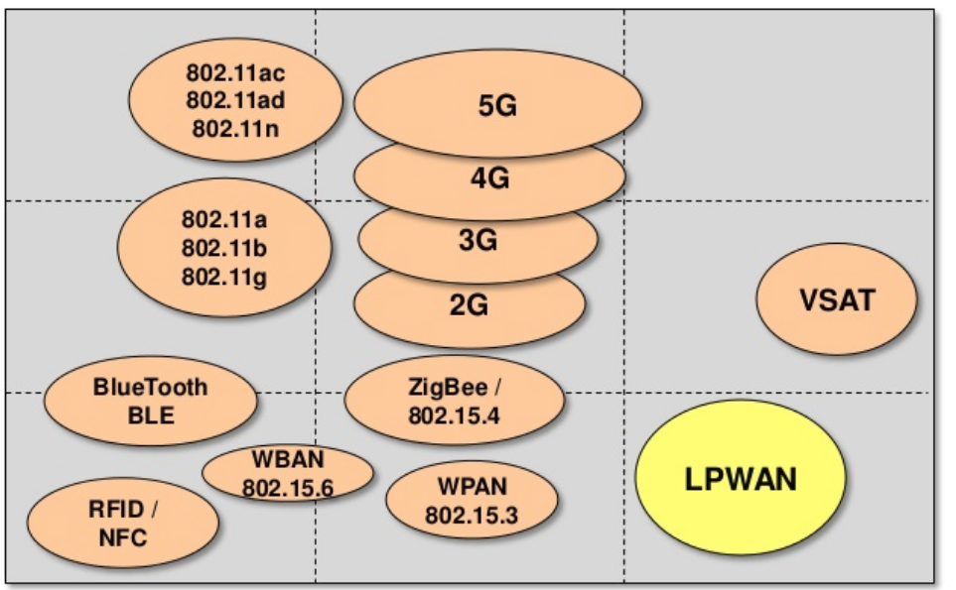
Introduction
Design Goals and Techniques
Proprietary Technologies
Standards
Challenges and Open Research Directions
Conclusion
Introduction
Number of connected M2M devices and consumer electronics will surpass the number of human subscribers by 2020 [1]
IoT industry is expected to generate a revenue of 4.3 trillion dollars by 2024 [2]
How to provide connectivity for low power devices distributed over large geographical areas?
LPWA application areas;
Smart city
Personal IoT
Smart grid metering
Agriculture
Industrial assets monitoring
Home automation
Logistics
Wildfire monitoring
LPWAN fills the technology gap between;
Short range wireless technologies (ZigBee, Bluetooth, Wi-Fi)
Very costly to deploy massive/dense # of devices
Cellular (2G, 3G, 4G)
Optimized for voice and data
Complex and expensive
High power consumption
DATA RATE
RANGE
Figure 1: Wireless technologies with respect to range and data rate¹
1. Image Source: https://www.slideshare.net/PeterREgli/lpwan
Notes:
The range of short range wireless technologies is limited to a few hundred meters at best. Dense deployment needed. Multihop, mesh

Slide 4
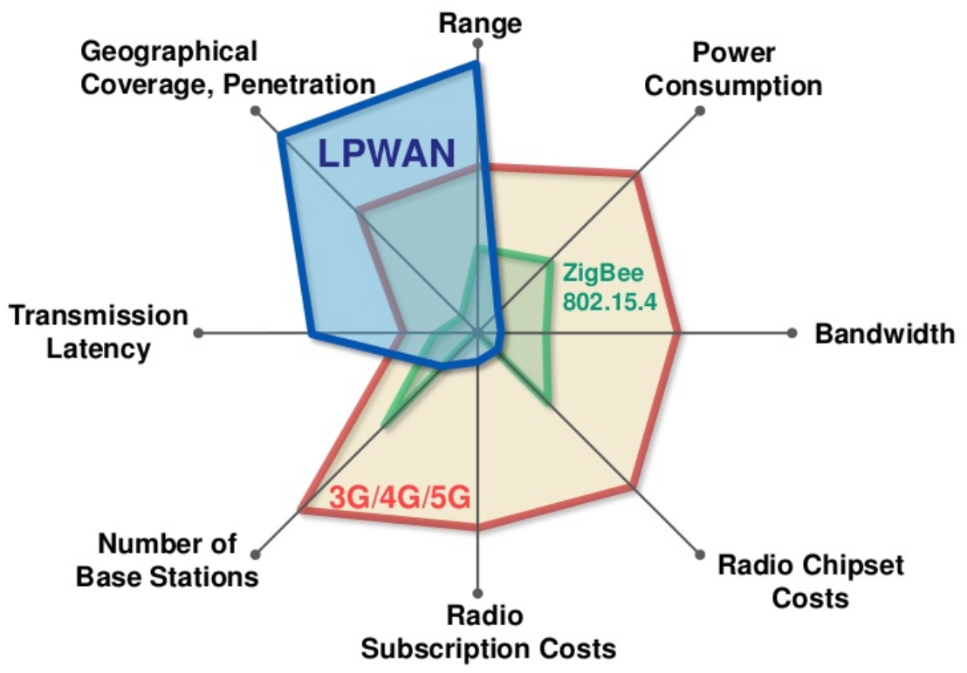
Introduction
Design Goals and Techniques
Proprietary Technologies
Standards
Challenges and Open Research Directions
Conclusion
Introduction
Low Power Wide Area (LPWA) networks;
Low power (ten years and beyond)
Long range (a few to tens of kilometers)
Low cost
High scalability
Low data rate (in orders of tens of kilobits per seconds)
High latency (in orders of seconds or minutes)
LPWAN applicable applications;
Delay tolerant
Low data rates
Low power consumption
Several competing standards development organizations;
ETSI
3GPP
IEEE
IETF
Several competing alliances;
LoRaTM Alliance
Weightless SIG
DASH 7 Alliance
Figure 2: Wireless technologies with respect to various properties¹
1. Image Source: https://www.slideshare.net/PeterREgli/lpwan
Notes:
LPWAN is not suitable for many industrial IoT, vehicle to vehicle (V2V), and vehicle to infrastructure (V2I) applications
European Telecommunications Standard Institute
Third Generation Partnership Project
Institute of Electrical and Electronics Engineers
Internet Engineering Task Force

Slide 5
Introduction
Design Goals and Techniques
Proprietary Technologies
Standards
Challenges and Open Research Directions
Conclusion
Design Goals and Techniques
Key objectives of LPWAN technologies; long range + low power + low cost
Long range
Sub-GHz band
Lower frequency signals experience less attenuation and multipath fading
Special modulation techniques
Designed to achieve a link budget of 150 ± 10 dB that enables a range of a few km and tens of km
Two classes of main modulation techniques;
Narrowband; encoding the signal in low bandwidth (usually less than 25kHz)
Reduce noise, decrease data rate
Spread spectrum; spread signal over a wider frequency band but with the same power density
Resilient to interference, harder to decode
Low cost
Cost of hardware should below $10 and connectivity subscription per unit should low as $1
Reduction in hardware complexity
Minimum infrastructure
Using license-free or already owned licensed bands
Notes:
Key objectives are conflicting each other.
Narrowband share the overall spectrum very efficiently between multiple links. NB-IoT, WEIGHTLESS-P and SIgFox (100Hz)
Compared to the cellular and the short range wireless technologies
dense and therefore an expensive deployment

Slide 6
Introduction
Design Goals and Techniques
Proprietary Technologies
Standards
Challenges and Open Research Directions
Conclusion
Design Goals and Techniques
Ultra low power operation
Simple topology
No mesh, direct connection from end devices to base stations
Duty cycling
End devices to turn off their transceivers when not required
Lightweight medium access control
Widely used MAC protocols (cellular, WLAN) are too complex. Mostly ALOHA is used
Offloading complexity from end devices
Simplify the design of end devices, move complexity to base stations and backend system
Scalability
Diversity; channel, time, space, and hardware
Densification
Adaptive channel selection and data rate
Quality of service
Limited or no QoS
Notes:
Backend system adapts communication parameters (such as data rate/ modulation parameters)
not to waste precious energy in busy-listening to other devices
No CSMA/CA

Slide 7
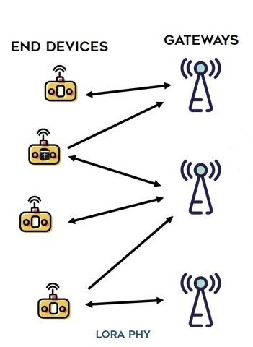
Introduction
Design Goals and Techniques
Proprietary Technologies
Standards
Challenges and Open Research Directions
Conclusion
Proprietary Technologies
Sigfox
Patented, proprietary base stations and proprietary network operator
Ultra-low power consumption and inexpensive antenna design
Maximum uplink throughput of only 100 bps!
140 12-byte uplink and 4 8-bytes downlink messages limit per day!
Single message is transmitted multiple times (3 by default) for reliability, no acknowledgments
LoRa
Modulates the signals in Sub-GHz ISM band using a proprietary spread spectrum technique CSS
Resilient to interference and noise
Multiple spreading factors (between 7-12) to decide the tradeoff between range and data rate
Data rate ranges from 300 bps to 37.5 kbps depending on spreading factor
The messages transmitted by the end devices are received by all the base stations in the range -> localization
LoRaWAN is open standard MAC layer protocol for LoRa physical layer
Battery Powered – Class A
Low Latency – Class B
No Latency – Class C
Figure 3: LoRa Topology¹
1. Image Source: https://i1.wp.com/www.zerynth.com/wp-content/uploads/2017/05/lorawan-architecture.jpg?resize=1024%2C561&ssl=1
Notes:
Higher spreading factors delivers long range at an expense of lower data rates and vice versa

Slide 8
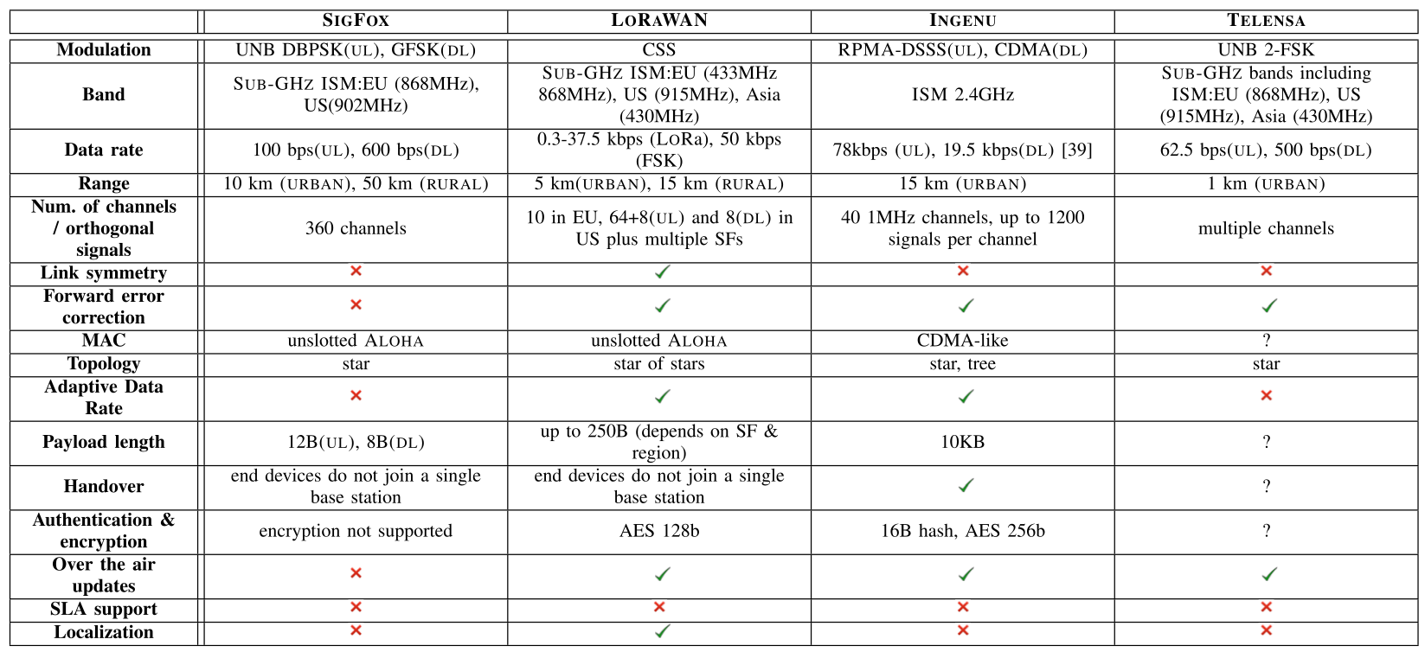
Introduction
Design Goals and Techniques
Proprietary Technologies
Standards
Challenges and Open Research Directions
Conclusion
Proprietary Technologies
Table 1: Technical specifications of proprietary LPWA technologies

Slide 9







Introduction
Design Goals and Techniques
Proprietary Technologies
Standards
Challenges and Open Research Directions
Conclusion
Organizations for Standards

Slide 10
Introduction
Design Goals and Techniques
Proprietary Technologies
Standards
Challenges and Open Research Directions
Conclusion
Developed Standards
802.15.4k
Why Standards:
Unified end user experience
GSM and IS-95 in 2G
Reduced project risks
Enable easier and cheaper integrity
To achieve inter-vendor operability
Reducing investment costs
Enable in-house developments
Which is very valuable for IoT environment
Objectives of SDOs and SIGs are diverse.
In the long run, it is expected to enable coexistence of competing Technologies with the adaptation of these standards.
IEEE
802.15.4g
802.11: Long Range Low Power (LRLP)
ETSI
Low Throughput Networks (LTN)
Enhanced MTC (eMTC)
LPWA Standards
3GPP
Extended Coverage GSM (EC-GSM)
Narrowland IoT (NB-IoT)
IEFT
6LPWA/LP-WAN
Weightless-SIG
Weightless-W/N/P
LoRa Alliance
LoRaWAN
Dash7 Alliance
DASH7
Figure 4: LPWA standards and their developing organizations.

Slide 11
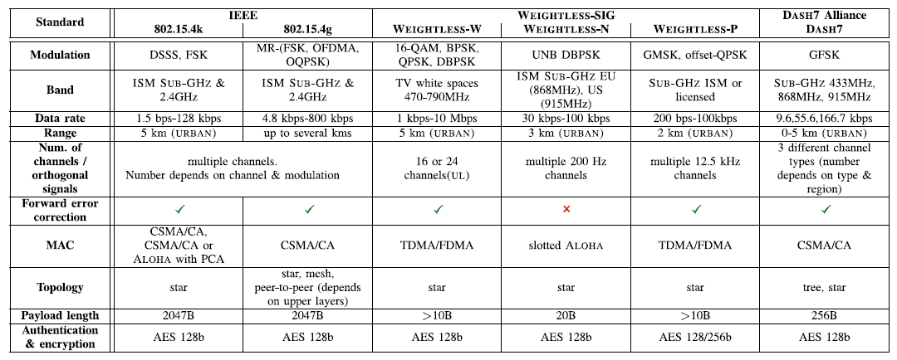
Introduction
Design Goals and Techniques
Proprietary Technologies
Standards
Challenges and Open Research Directions
Conclusion
Comparison of Standards
Table 2: Technical specifications of various LPWA standards (?=Not known)
Notes:
DSSS Direct Sequence Spread Spectrum

Slide 12
Introduction
Design Goals and Techniques
Proprietary Technologies
Standards
Challenges and Open Research Directions
Conclusion
Challenges and Open Research Directions
LPWA striving hard to deliver innovative solutions securing carrier grade performance in case of:
Scaling networks to massive number of devices
Interference control and mitigation
High data rate modulation techniques
Interoperability between different LPWA technologies
Localization
Link optimizations and adaptability
Testbeds and tools
Authentication, security & privacy
Mobility & roaming
Support for service level agreements
Co-Existence of LPWA technologies with other wireless networks
Support for data analytics

Slide 13
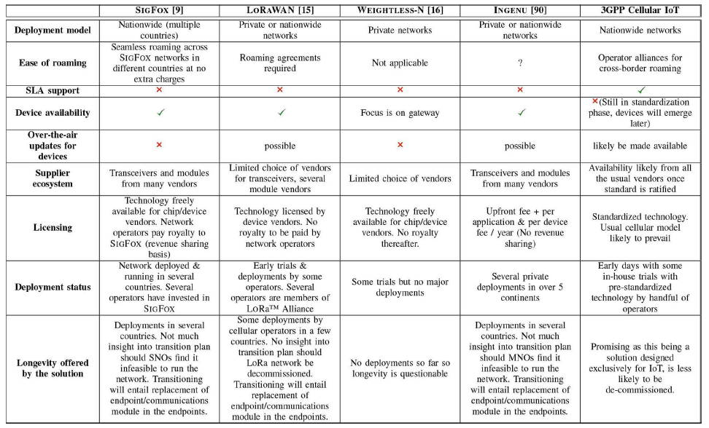
Introduction
Design Goals and Techniques
Proprietary Technologies
Standards
Challenges and Open Research Directions
Conclusion
Challenges and Open Research Directions
Table 3: Business considerations for various LPWA technologies (?=Not known)

Slide 14
Introduction
Design Goals and Techniques
Proprietary Technologies
Standards
Challenges and Open Research Directions
Conclusion
Conclusion
In this paper:
Low Power Wide Area Network Technologies and Standards surveyed.
Design criterias and Open Research Areas on this topic briefly described.
Business considerations are given.
LPWA applications in different sectors are sampled.
It is observed that:
Key features of a LPWA technology are;
Low power consumption
Wide area coverage
Inexpensive wireless connectivity
Each technology driven by different SDOs/SIGs have pros and cons
There exists several common vulnerabilities in LPWA motivating researchers
Existing Technologies in MAC & PHY layers does not fulfill LPWA design principles
Many Technologies with different design principles causing questionmarks about interoperability
3GPPs NB-IOT still in draft state, it would provide a main standard for all organizations to follow

Slide 15


